Slide 1
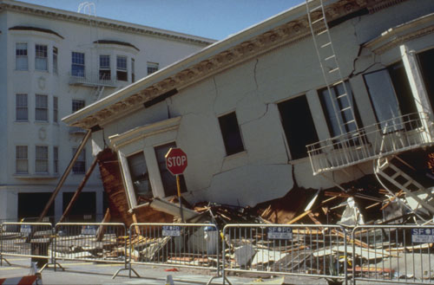





Earthquake Hazards
I. Earthquake Hazards
II. Tsunami Hazards

Slide 2
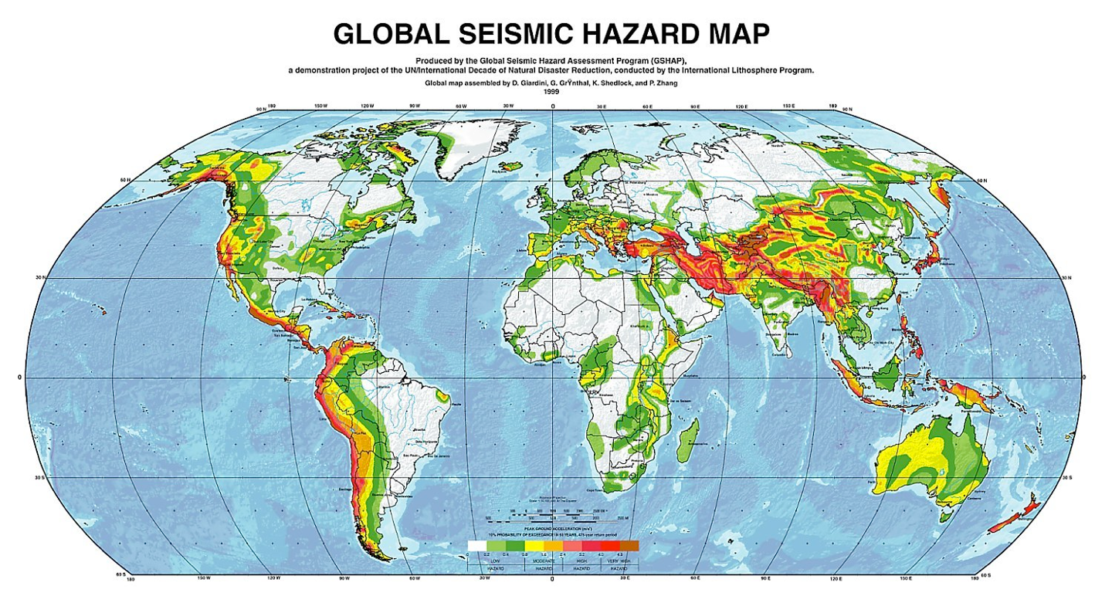
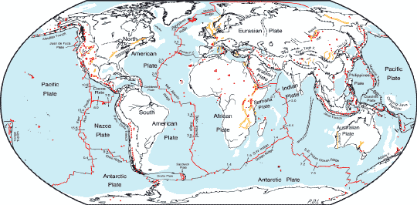
1. Earthquake Hazards
It is clear that the major earthquake risk is associated tectonic plate boundaries (largest risk with convergent boundaries).
Global Tectonic Map
NASA

Slide 3
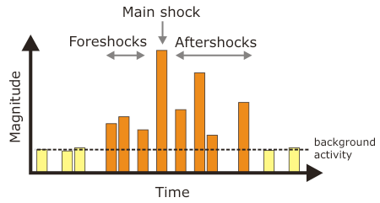
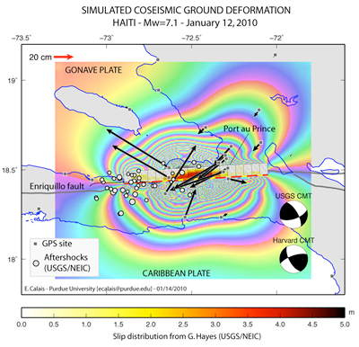
Short-term Earthquake Prediction
It is not possible to predict earthquakes on a short-term basis.
There is active research on short-term predictions. There are other phenomena that may occur just prior to a large earthquake. These precursors include:
1. Increase in number of foreshocks
2. Surface deformation
3. Changes in the electrical resistance of rocks
4. Changes in groundwater levels (measured in wells)
5. Increased emission of radon gas
6. Radio signals from rock strain or saline groundwater
USGS

Slide 4
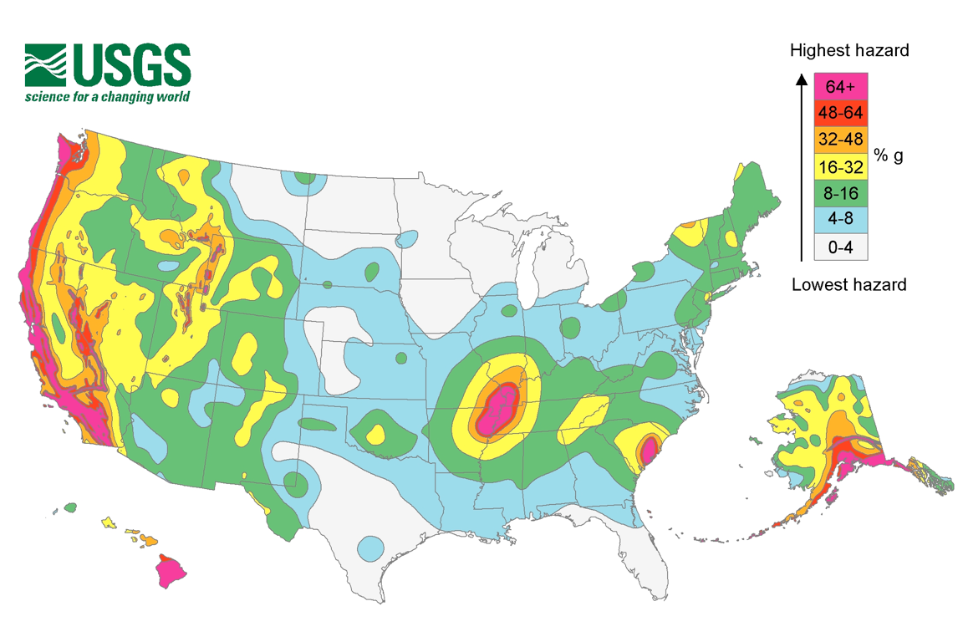
Long-term Earthquake Prediction
In a seismically active area, it is clear that a large earthquake is more likely to occur as time passes since the last major event.
Long-term predictions based on statistical probabilities are more successful. This is similar to weather forecasts in that they make predictions about the probability of a event in a specific period of time.
This map indicates the seismic risk for the U.S. as the strength of horizontal ground motion (relative to gravity) with a 10% chance of occurring in the next 50 years.
Note that three-quarters of all expected losses due to earthquakes will occur in California.

Slide 5
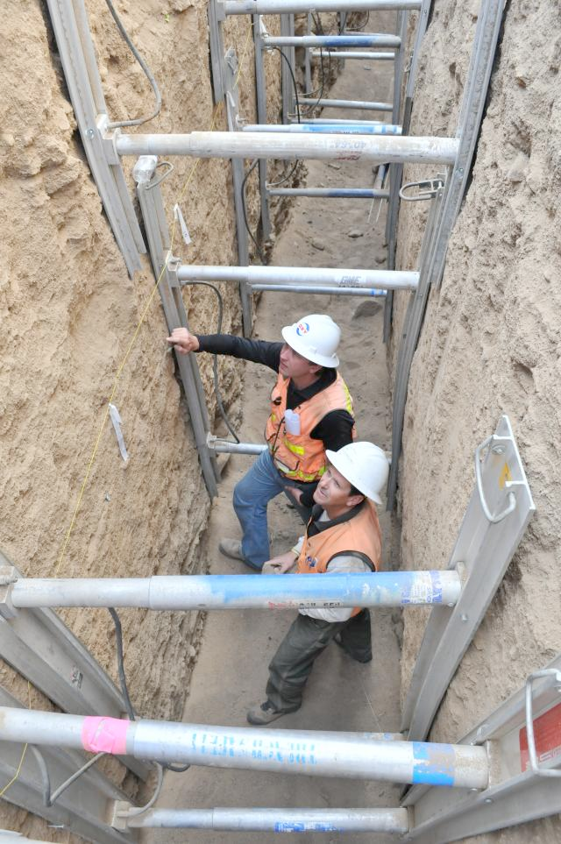
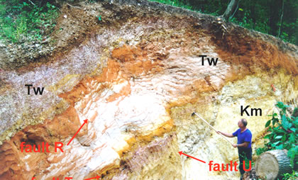
Probability maps are commonly produced from data on earthquakes that have occurred over time. Unfortunately, the historic record only goes back a few hundred years.
Geologists can extend the record further back in time by trenching a region find evidence of prehistoric earthquakes recorded in sediments. Dating of these events may be accomplished with ¹⁴C dating.
U.S. Army
MO DNR

Slide 6
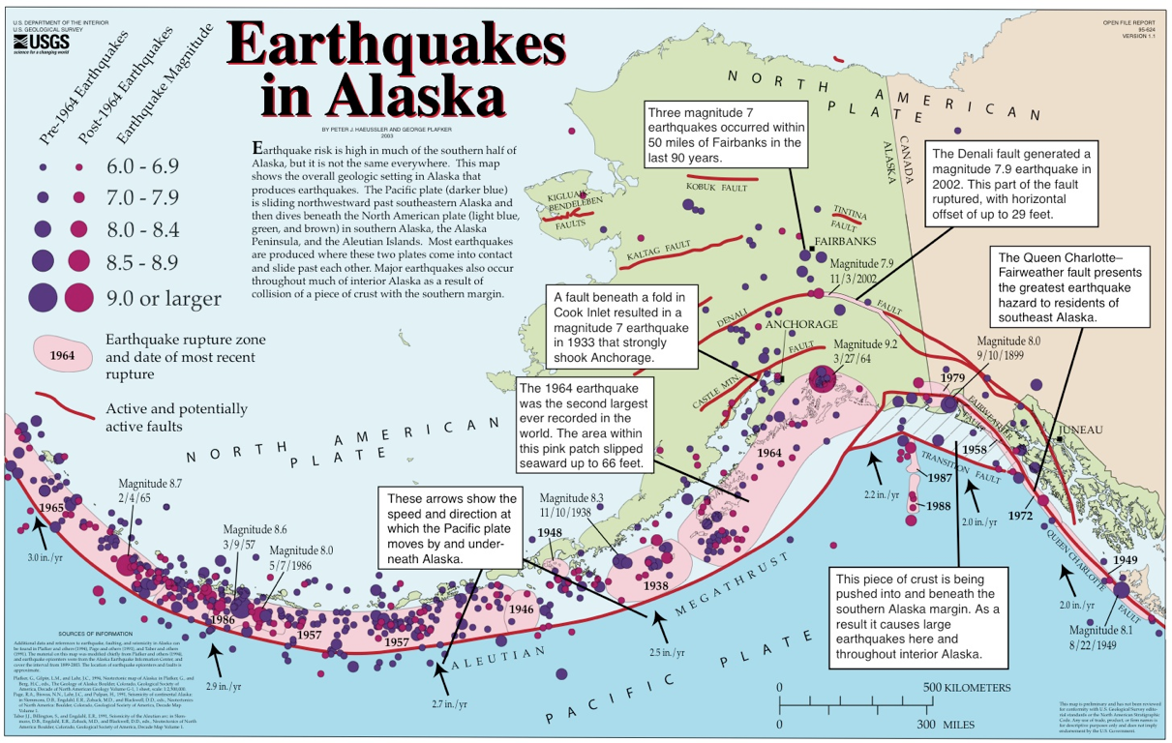
A seismic gap is an area along an active fault where strain has not been released for an extended period of time.
Mapping seismic gaps may be useful in predicting large earthquakes since they may be more likely to occur in this area to relieve accumulated strain.
These seismic gaps may indicate where the next large earthquake may occur.
This map shows the epicenters of earthquakes in the Aleutian subduction zone and the pink areas show the rupture zones of recent earthquakes.
Can you identify any seismic gaps?

Slide 7
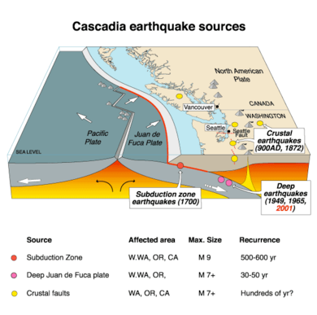
There has not been a great earthquake along the Cascadia subduction zone in over 300 years. The last great quake occurred in 1700 (estimated M8.7-9.3)
The table shows when earthquakes may have occurred on the Cascadia subduction zone in the last 3500 years and suggests a recurrence interval ~300-600 years.
The entire Cascadia subduction zone may be thought of as a seismic gap.
USGS
Estimated Year | Interval
1440-1340 BCE | -
980-890 BCE | 250
660-440 BCE | 400
350-420 BCE | 910
690-730 BCE | 330
780-1190 BCE | 210
1700 BCE | 780
Atwater et al., 2005
USGS

Slide 8
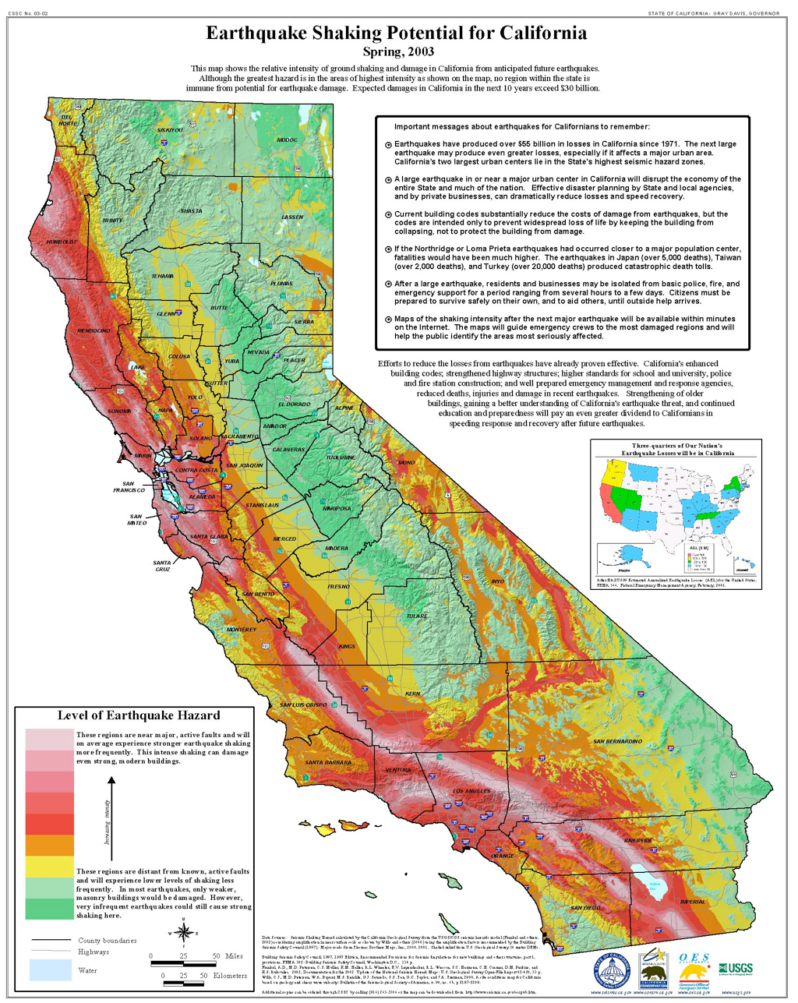
Note that the majority of seismic risk in California is associated with the San Andreas fault system.
There is additional seismic risk associated with faults in the Sierra Nevada and the Cascadia subduction zone.
It is expected that losses due to earthquakes will exceed $30 billion in the next 10 years.

Slide 9
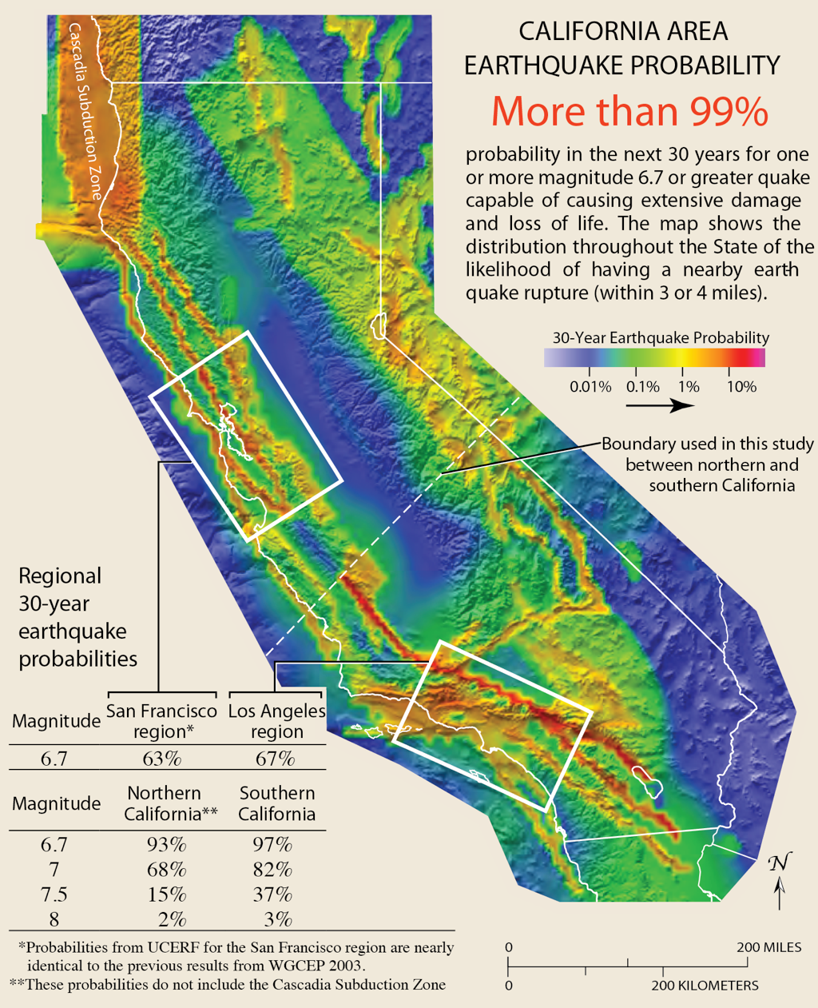
In California, it is not a question about if the “big one” will occur, it is a question about when.
There is a 99% chance of an earthquake with ≥M6.7 in the next 30 years.
USGS

Slide 10
There is a 72% probablility of a M>6.7 earthquake in the SF Bay area. This map shows the that the greatest risk in the S.F. Bay Area is associated with the Hayward fault (33% probability) followed by the Calaveras fault (26% probability).
USGS

Slide 11
Rate the Risk

Slide 12
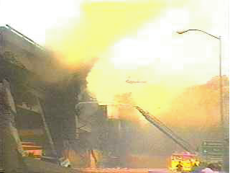
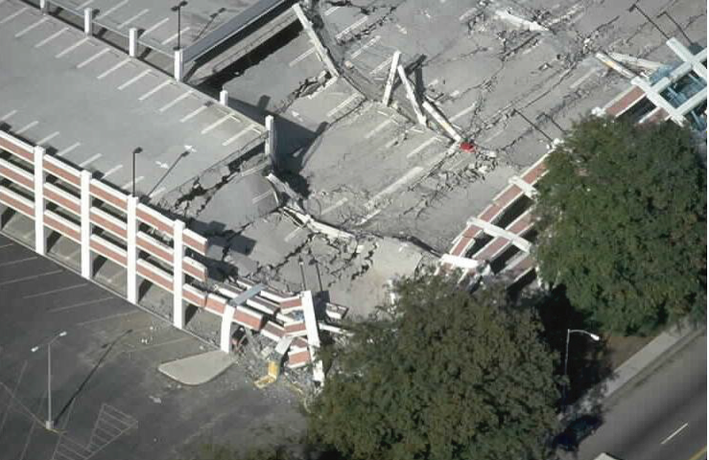
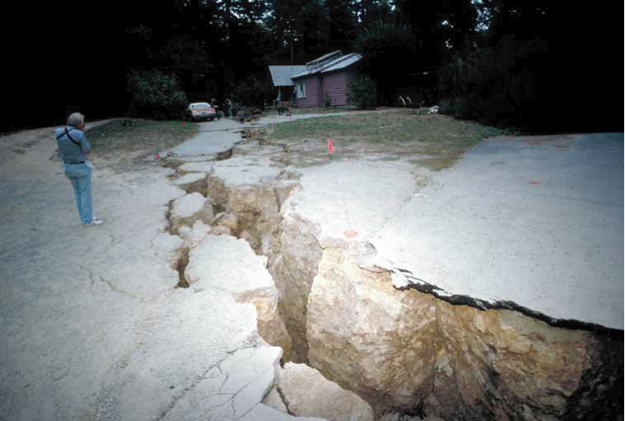
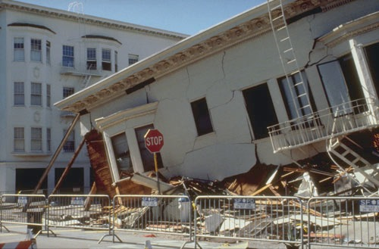
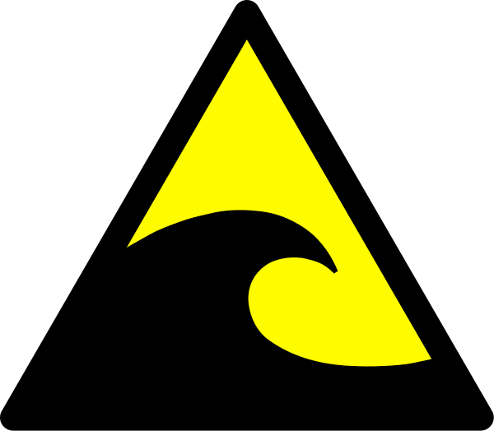
Earthquake Hazards
Direct hazards
1. ground rupture
2. shaking
Indirect hazards
3. landslides
4. liquefaction and ground subsidence
5. tsunamis
6. fire
USGS
USGS

Slide 13
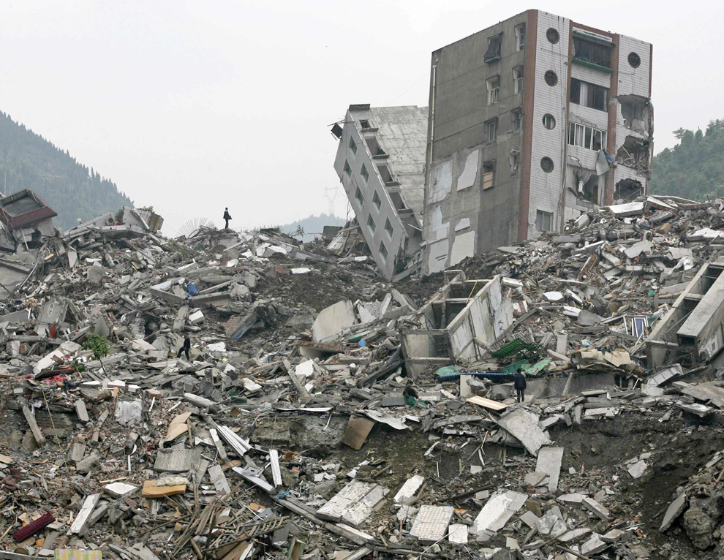
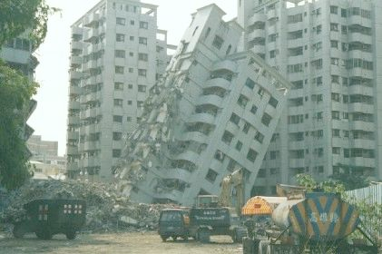
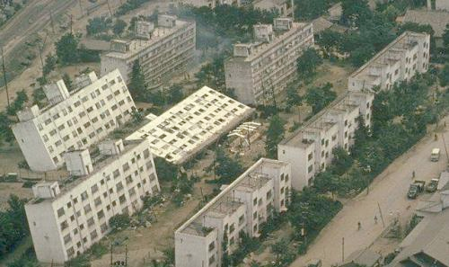
Seismic Engineering
Seismic engineering involves designing structures to “survive” an earthquake by increasing structural strength (with respect to shear) and installing systems that reduce the amount of shear on the structure.

Slide 14
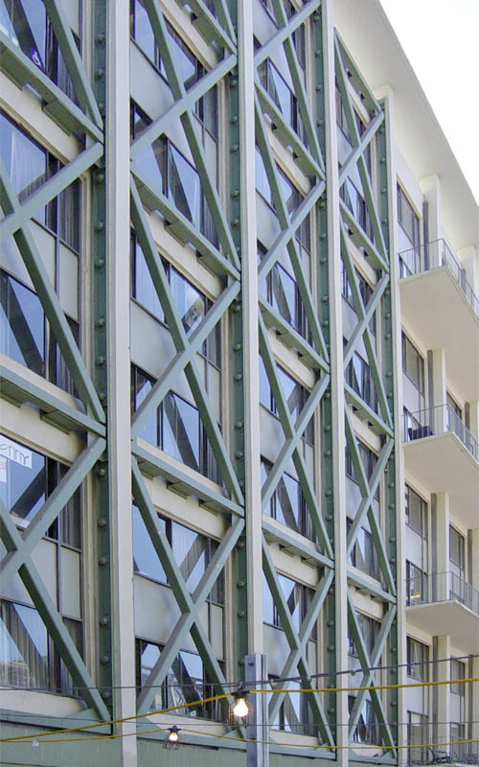
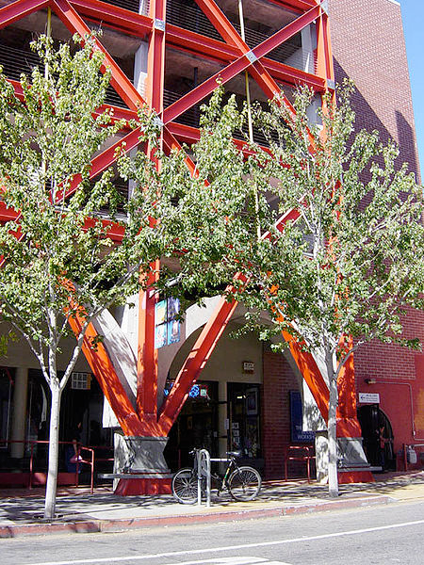
Cross-bracing is an element that reinforces building structures with diagonal supports that increase a building’s ability to withstand shear and shaking.
Cross-bracing is usually seen with two diagonal supports placed in an X shape and is common as an external superstructure or internal support.

Slide 15
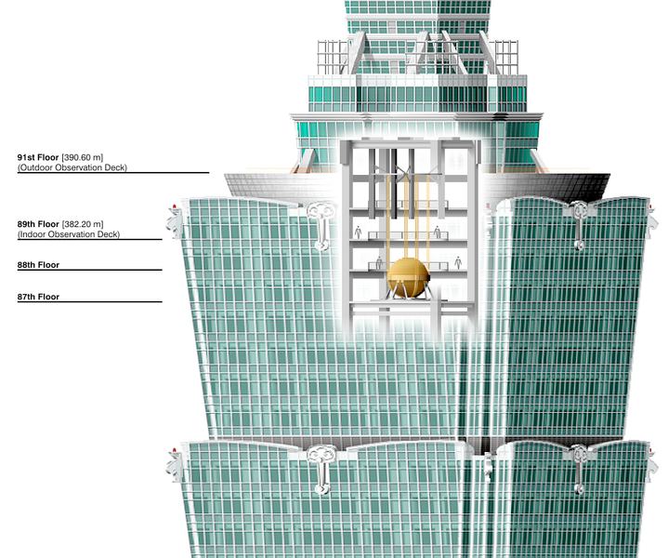
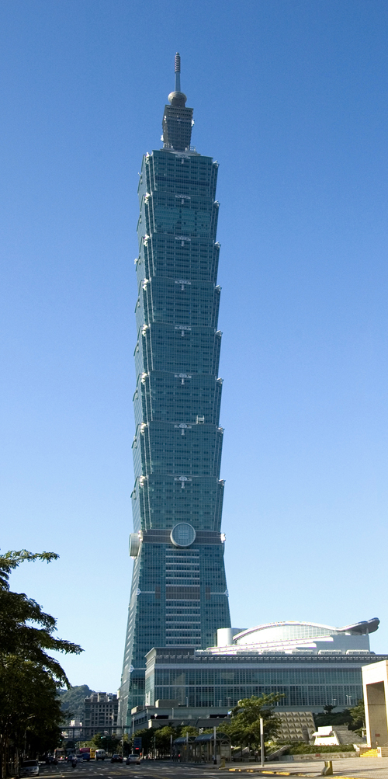
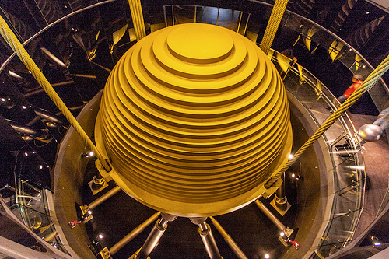
Mass dampers are huge concrete blocks mounted in skyscrapers that move in opposition to the resonance frequency oscillations of structures.
The Taipei 101 building has a steel pendulum weighing 660 tons that serves as a tuned mass damper. It is suspended from the 92nd to the 88th floors and sways to decrease resonant amplifications of lateral displacements in the building caused by earthquakes and strong winds.
Wikipedia: Someformofhuman
Wikimedia: Armaud du Plessis
Wikimedia: Alton Thompson

Slide 16
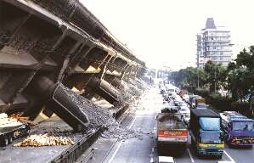
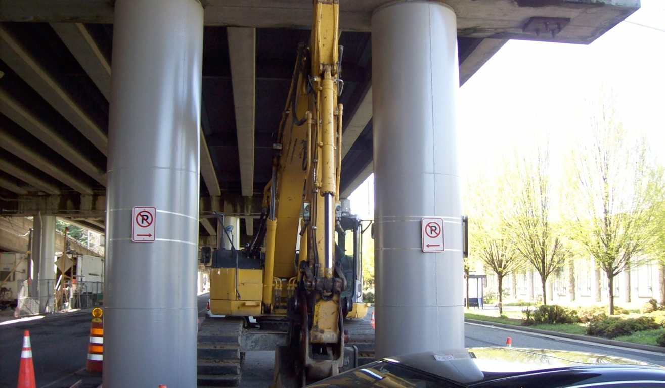
Concrete column failure is a significant problem since such columns are support structures for freeways and buildings.
U.S. DOT
Columns can be designed or retrofitted with steel jackets and steel spiral wrapping to reinforce them.
Seattle Department of Transportation

Slide 17
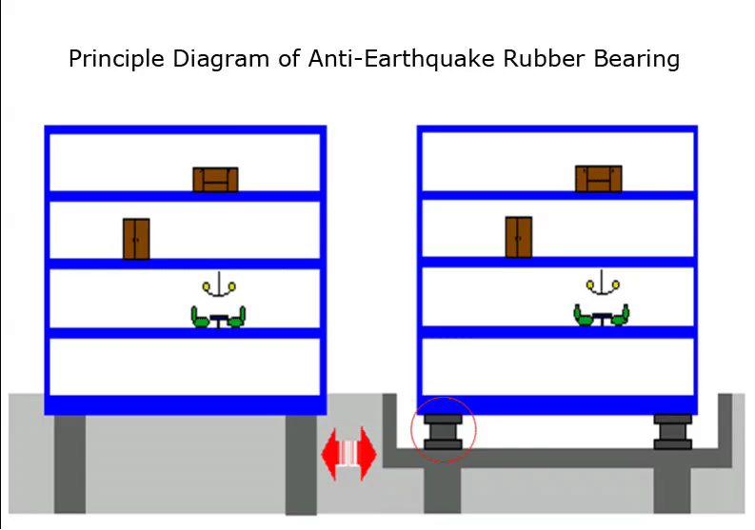
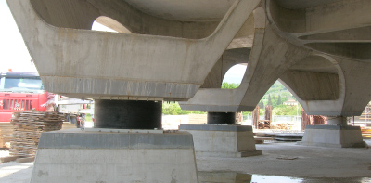
Base isolation involves placing rubber bearings (or other devices such as steel springs) between a building at its foundation supports. It decouples a building’s superstructure from its substructure and reduces the amount of shaking and shear in the superstructure.
Rubber Import and Export
Base isolation is one of the most common types of seismic reinforcement and can be designed into a new building or by retrofit.
Italian National Agency for New Techologies

Slide 18
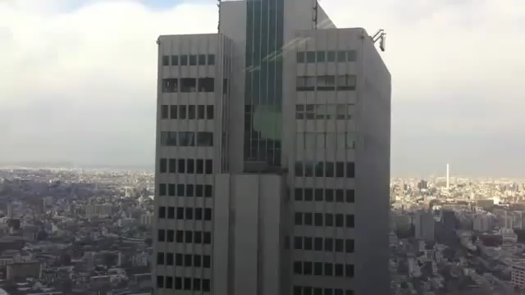
YouTube: YamachanUS
http://www.youtube.com/watch?v=NisWbAXfyWI
This is a video of skyscrapers swaying from an earthquake.
This is the way we hope our buildings will perform during an earthquake.

Slide 19
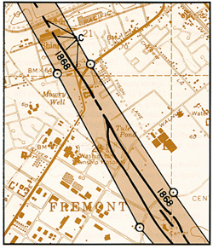
The Alquist-Priolo Earthquake Fault Zoning Act was signed into California law on December 22, 1972 to mitigate the hazard of surface faulting to structures for human occupancy. The Act was one of several that changed building codes and practices to improve earthquake safety.
The act in its current form has three main provisions:
Compilation of detailed maps of known active faults.
Requires property owners to legally disclose that their property lies within the zones defined on those maps before selling the property; and
Prohibits new construction within these identified fault zones unless a comprehensive geologic investigation shows that the fault does not pose a hazard to the proposed structure.

Slide 20
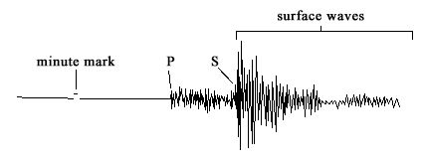
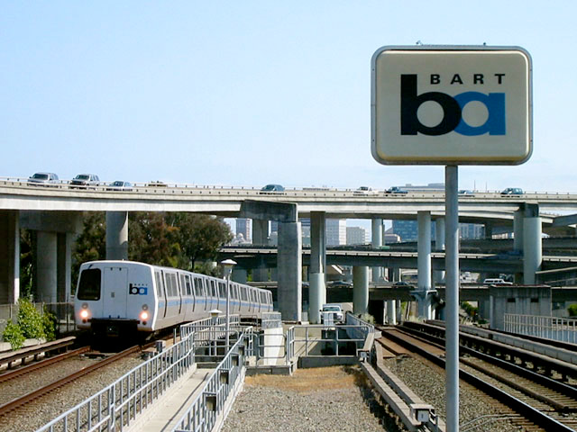
Early Warning Systems
Earthquake warning systems may take advantage of the lag time between the arrival of a P-wave and the arrival of the S- and surface-waves. The further that a city is away from the epicenter, the greater the time lag.
The warning time may range from a few seconds to a minute. Generally, if a city is so distant that the lag time is more than a ~1 minute, the city is too distant to from the epicenter and damage will be minimal.
Even a warning of a few seconds may be enough for people to seek shelter or to allow transportation and utility systems (i.e., gas pipelines) to shut down automatically.

Slide 21
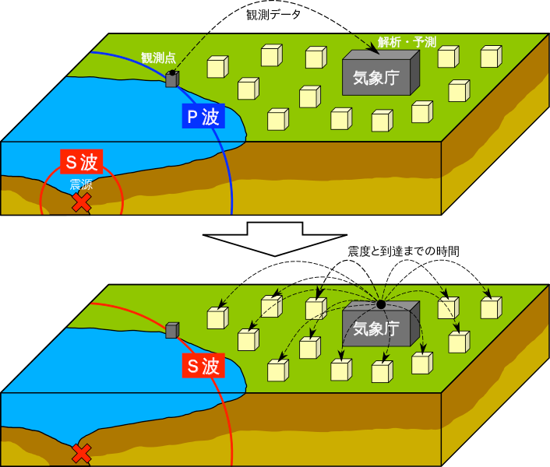
The Earthquake Early Warning (EEW) system in Japan is managed by the Japan Meteorological Agency (JMA).
When two or more seismometers detect P-waves (upper diagram), the data is analyzed immediately by the JMA. Then a warning is issued to broadcasting stations and mobile phone companies (lower diagram).
Warnings are issued by public address systems, TV, radio, internet, and mobile phones.
Japan Meteorological Agency

Slide 22
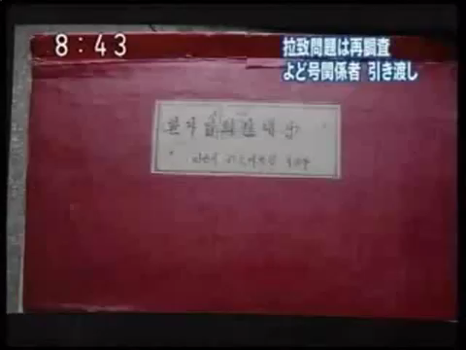
This is a video of the Japanese earthquake early warning system breaking into TV program to warn of an earthquake.
YouTube: judypillsgarland69
http://www.youtube.com/watch?v=qqgAgJODgho

Slide 23
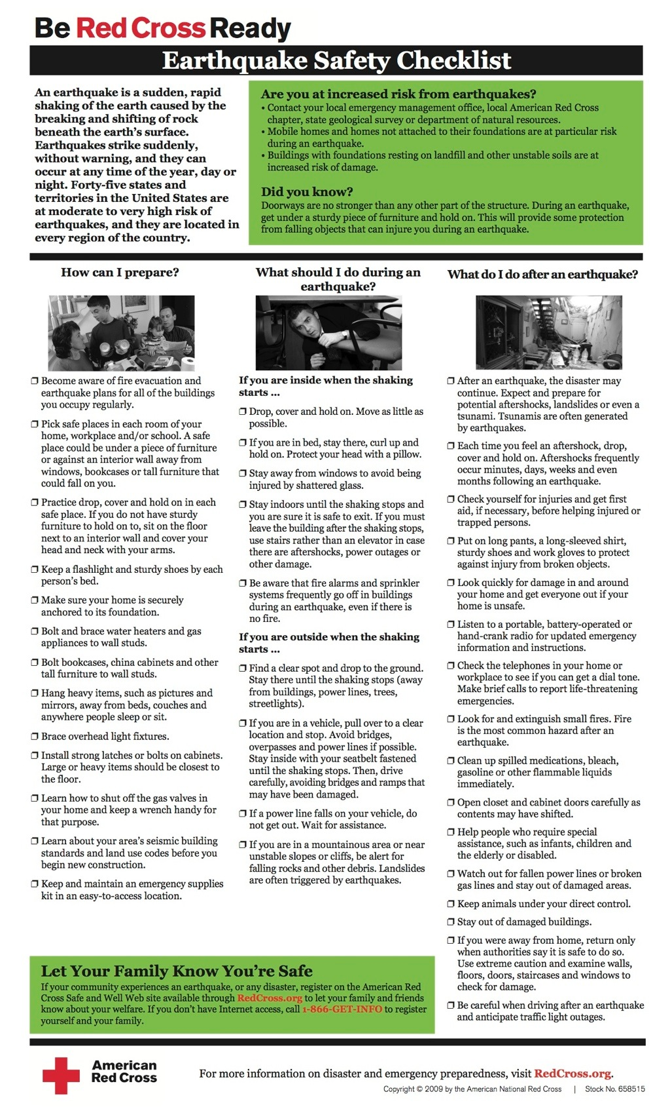
What do you do in the event of an earthquake?

Slide 24
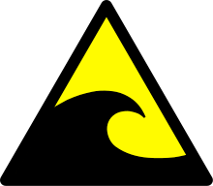
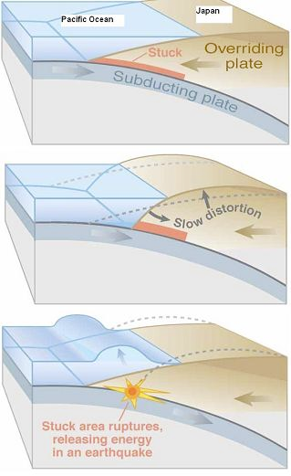
II. Tsunami Hazards
Tsunamis are giant water waves that usually result from the vertical displacement of the seafloor during an earthquake.
Tsunamis are usually produced by earthquakes along convergent boundaries since these produce the largest earthquakes and are located in ocean basins.
Tsunamis may also be produced by large submarine landslides and large meteorite impacts in ocean basins.
USGS

Slide 25
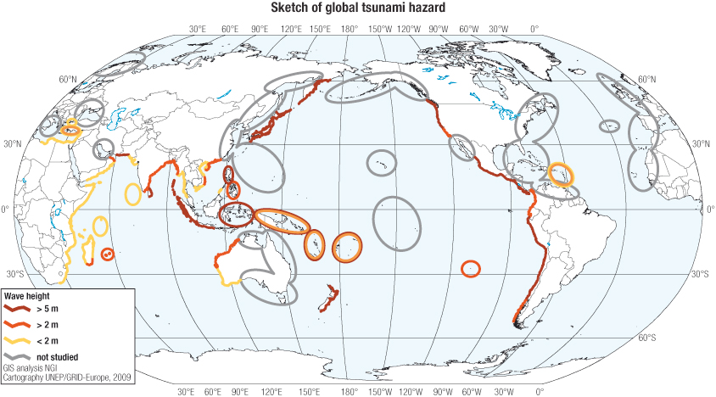
United Nations Office for Disaster Risk Reduction (UNISDR)
This map shows the global tsunami hazard. Note that the greatest hazard is on coastal regions in the Pacific basin. Japan, Indonesia, Chile, and Peru have a high number of people living in tsunami prone areas.

Slide 26
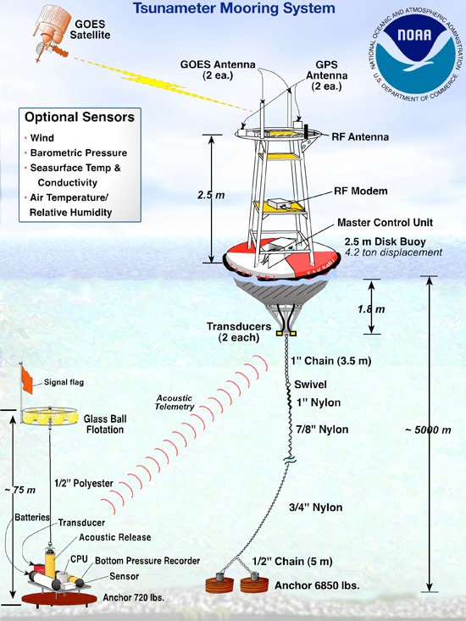
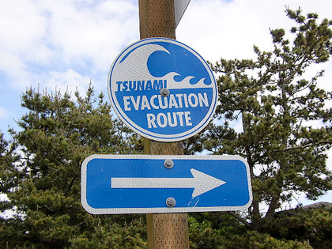
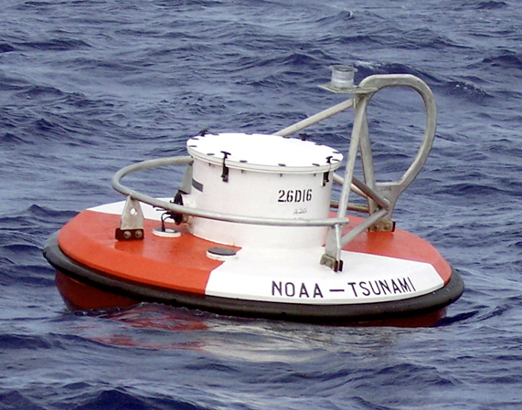
NOAA has deployed a new generation of tsunami detectors called the Deep-ocean Assessment and Reporting of Tsunamis (DART). The detectors can provide data so that a warning can be issued within minutes.

Slide 27
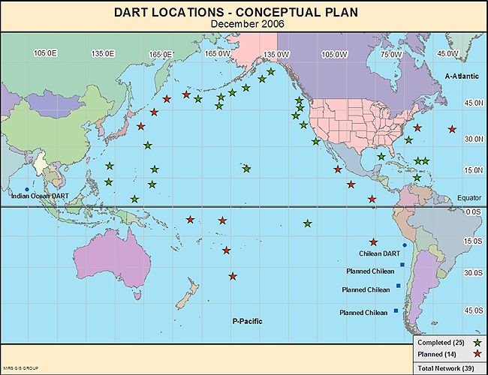
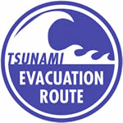
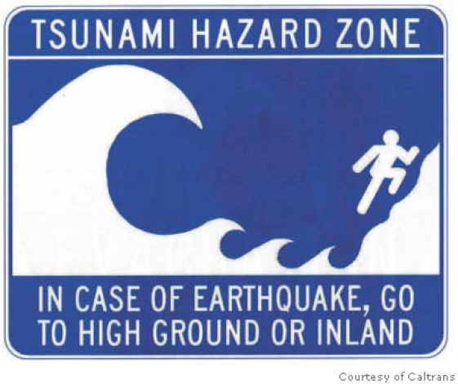
This map shows the locations of the DART detection system that is designed to alert the west coast of the U.S.
Pacific Tsunami Warning System
NOAA
There is not an effective tsunami warning system in the Indian Ocean.

Slide 28
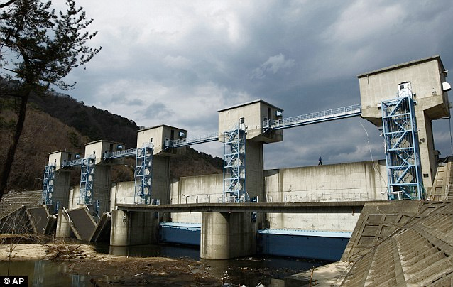
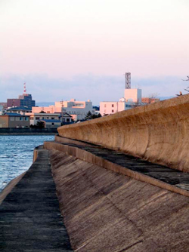
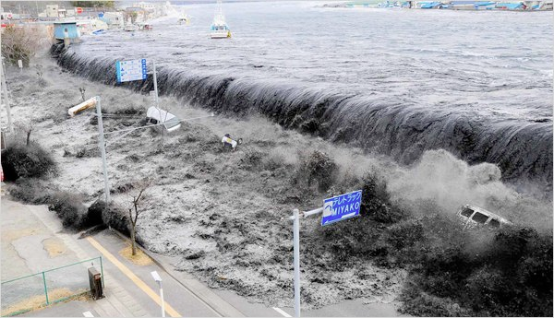
Tsunami barriers/walls help protect against waves and reduce inundation.
The lower image shows that a tsunami barrier that was overrun by a large tsunami.

Slide 29
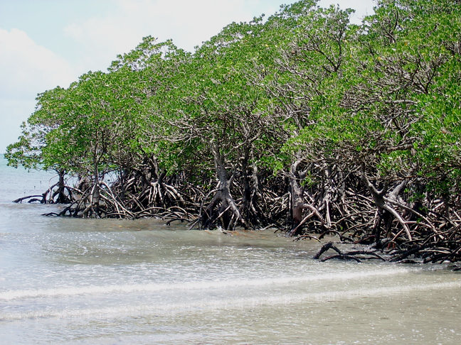
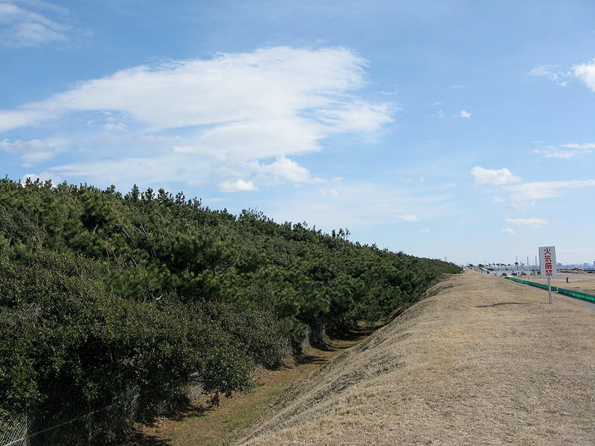
Evidence from recent tsunamis indicates regions with coastal forests were relatively protected from tsunamis. Some countries are experimenting with planting mangroves and casuarinas along the coast to help absorb the wave and reduce damage from a tsunami.
The bottom image shows a berm and forest designed to protect new towns in Makuhari (Chiba, Japan) from tsunamis.

Slide 30

An earthquake can occur in one area and the tsunami may inundate another thousand of km away. This map shows the propagation of the Tōhoku tsunami (2011) through the Pacific Basin.
NOAA

Slide 31

The Tōhoku earthquake (2011) caused a 5-8 m upthrust on the seafloor ~60 km offshore from the Tōhoku. This resulted in a major tsunami that propagated across the Pacific.
A wave height of ~38.9 meters (128 ft) was estimated at Omoe peninsula in Japan.
The coast of Chile was about 17,000 km away and was struck by tsunami waves 2 m (6.6 ft) high.
EERI

Slide 32



Frequently there is a large withdrawal of the ocean from the shoreline before a tsunami wave hits. These images show the withdrawal.
Tourists are often trapped by the wave since they think that it is a very low tide and follow the water out to search for seashells, etc.
The University of the West Indies Seismic Research Centre

Slide 33
Tsunami Propagation

